Slide 1
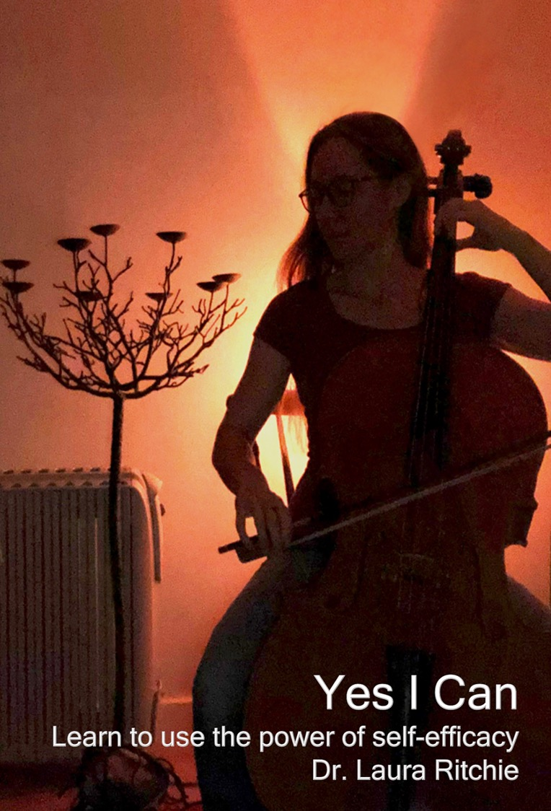
Yes I Can From Ideas to Print

Slide 2
TASK: Notice your Patterns
Two weeks
Observe and make notes:
How you work best?
Where you are – location?
When it is?
When roadblocks occur what do you think?
Image CC BY-NC by Chapandra

Slide 3
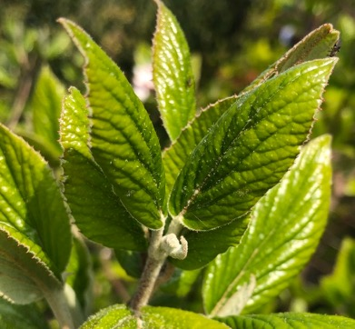
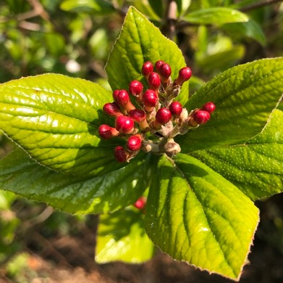
ACTIVITY:
Choose a topic that is currently meaningful to you (1 min)
Write down 5 words that really exemplify or are central to the topic (2 min)
Use each of the 5 words in a sentence,
to further explain them and/or give
context. (2 mins)

Slide 4
Make your lunch and eat it!
Describe a typical work-day lunch during lockdown.
Let’s add some variations!
Now that same lunch for…
Your boss and two colleagues from another university
For your students
For people who were your childhood neighbours.
Image CC BY-NC-ND by Omar Chatriwala

Slide 6
Per book basic cost

Slide 7
Pricing (Ingram Spark)

Slide 9
ACX requirements for audio files:
Contain only one chapter/section per file, with the section header read aloud
Running time no longer than 120 minutes
Have room tone at the beginning and end and be free of extraneous sounds
Measure between -23dB and -18dB RMS and have -3dB peak values and a maximum -60dB noise floor
Be a 192kbps or higher MP3, Constant Bit Rate (CBR) at 44.1 kHz

Slide 11
Credits…
Opening Credits Minimum Requirements "[title of audiobook]" "(subtitle if applicable)" Written by [name of author] Narrated by [name of narrator] | Closing Credits Minimum Requirements The End

Slide 13
Thank you! Please feel free to contact me: l.Ritchie@chi.ac.uk

